Slide 1
3- List Unpacking

Slide 2
context
List unpacking 3
Packing items in a list with * 6
Remember 5
Ex.1 7

Slide 3
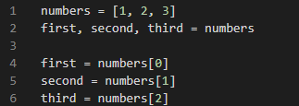
List unpacking

Slide 4
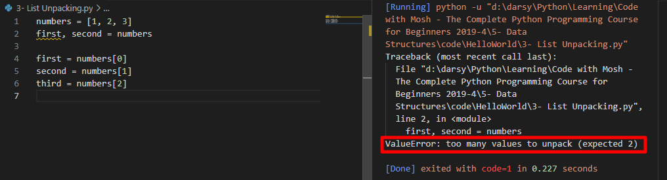
the number of variables that we have on the left side of the assignment operator should be equal to the number of items we have in the list.

Slide 5
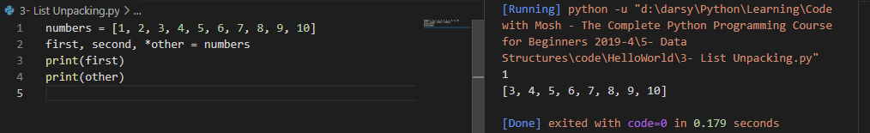
Packing items in a list with *
With This syntax will get the first and second items and everything else will be stored in a separate list
in this example. we have both unpacking and packing

Slide 6
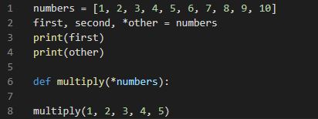
remember
when we prefix a parameter with an asterisk. Python would get all these arbitrary argument and packed them into a list This is exactly what is happening on line two

Slide 7
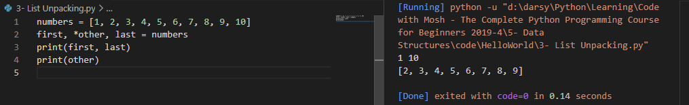
Ex.1
What if we care only about the first and the last item?

